Slide 1
Natural Language Processing with Disaster Tweets
Research Project
CS 834: Introduction to Information Retrieval
Presented by Tarannum Zaki
Department of Computer Science
Old Dominion University, Norfolk, Virginia
Oct 24, 2023

Slide 2
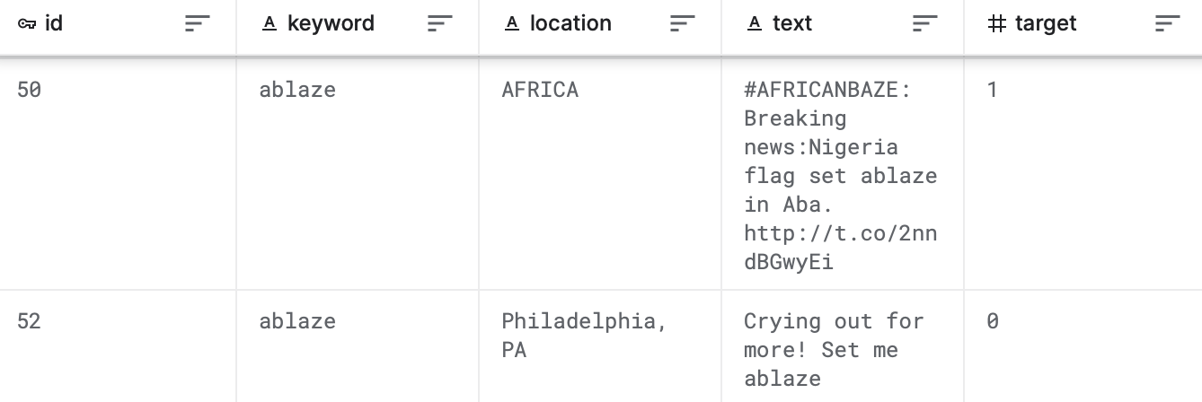
Dataset
A dataset of about 10,000 Tweets that were hand classified.
Split into training and testing dataset.
Data fields:
ID
Tweet text
Keyword
Location
Target
https://www.kaggle.com/competitions/nlp-getting-started/data
Tarannum Zaki CS 834 - Intro to Information Retrieval Natural Language Processing with Disaster Tweets @tarannum_zaki @WebSciDL

Slide 3
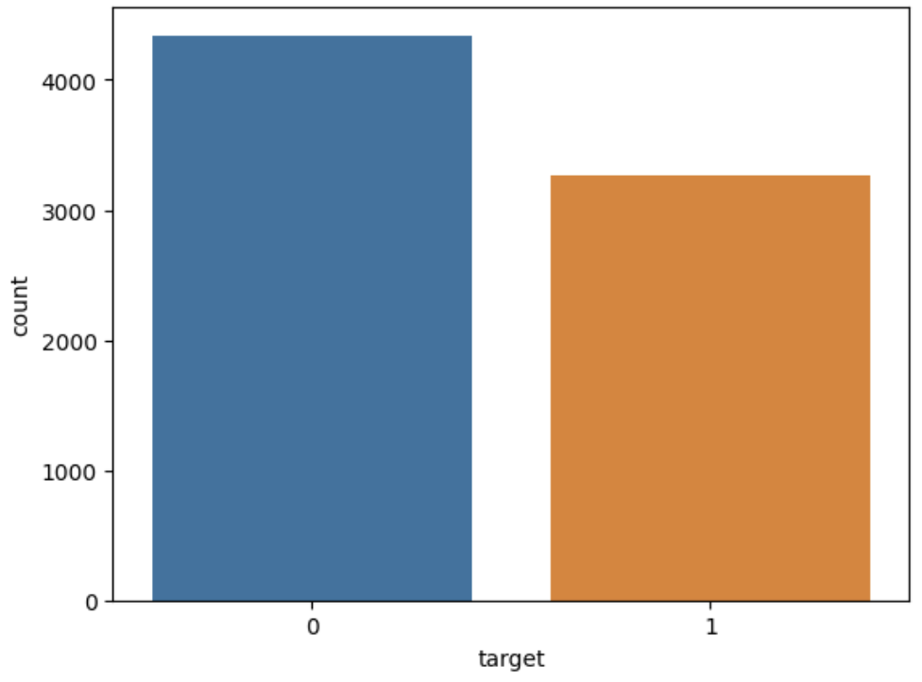
Exploratory Data Analysis (EDA)
Training dataset - 7,613 (70%) and Testing dataset - 3,263 (30%).
Both testing and training datasets have some null values for the fields ‘keyword’ and ‘location.’
Target count in training dataset:
0 : Non-Disaster Tweet (57%)
1 : Disaster Tweet (43%)
Moderately balanced dataset.
Tarannum Zaki CS 834 - Intro to Information Retrieval Natural Language Processing with Disaster Tweets @tarannum_zaki @WebSciDL

Slide 4
Data Preprocessing - Text
Text Cleaning and Tokenization
Converted all to lower case
Removed URLs
Removed punctuation
Removed hashtags
Removed numbers
Removed stopwords
Using string methods, regular expression module of Python, and NLTK corpus.
Text | 13,000 people receive #wildfires evacuation orders in California
Cleaned Text | people receive wildfires evacuation orders california
Tarannum Zaki CS 834 - Intro to Information Retrieval Natural Language Processing with Disaster Tweets @tarannum_zaki @WebSciDL

Slide 5
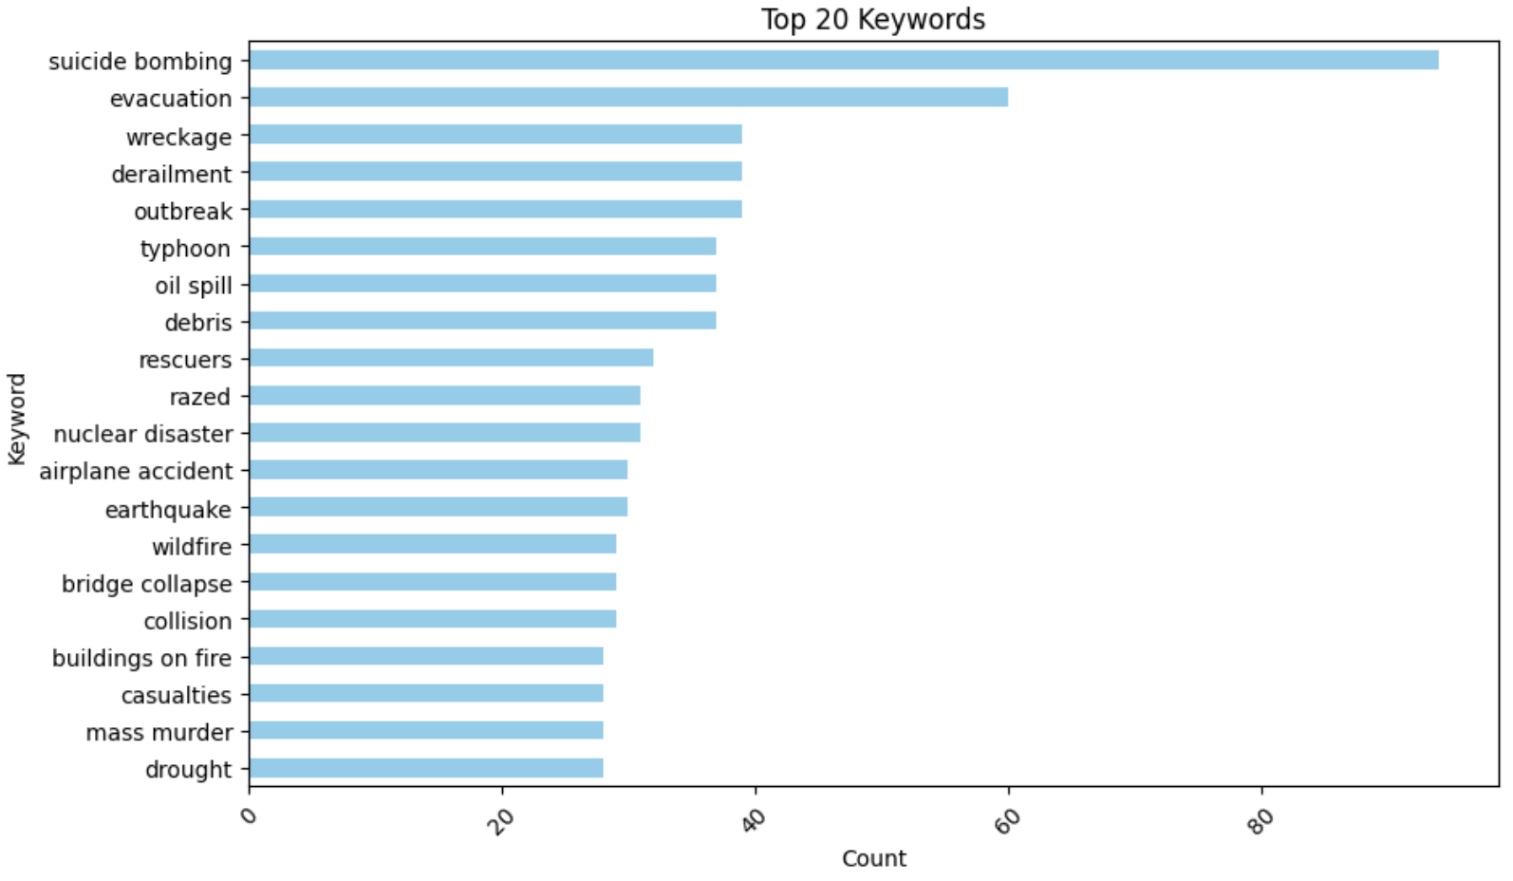
Data Preprocessing - Keyword
Text Cleaning
Removed numbers and symbols
Mapping equivalences
Top 20 disaster related keywords from the training dataset
Suicide bombing
Tarannum Zaki CS 834 - Intro to Information Retrieval Natural Language Processing with Disaster Tweets @tarannum_zaki @WebSciDL

Slide 6
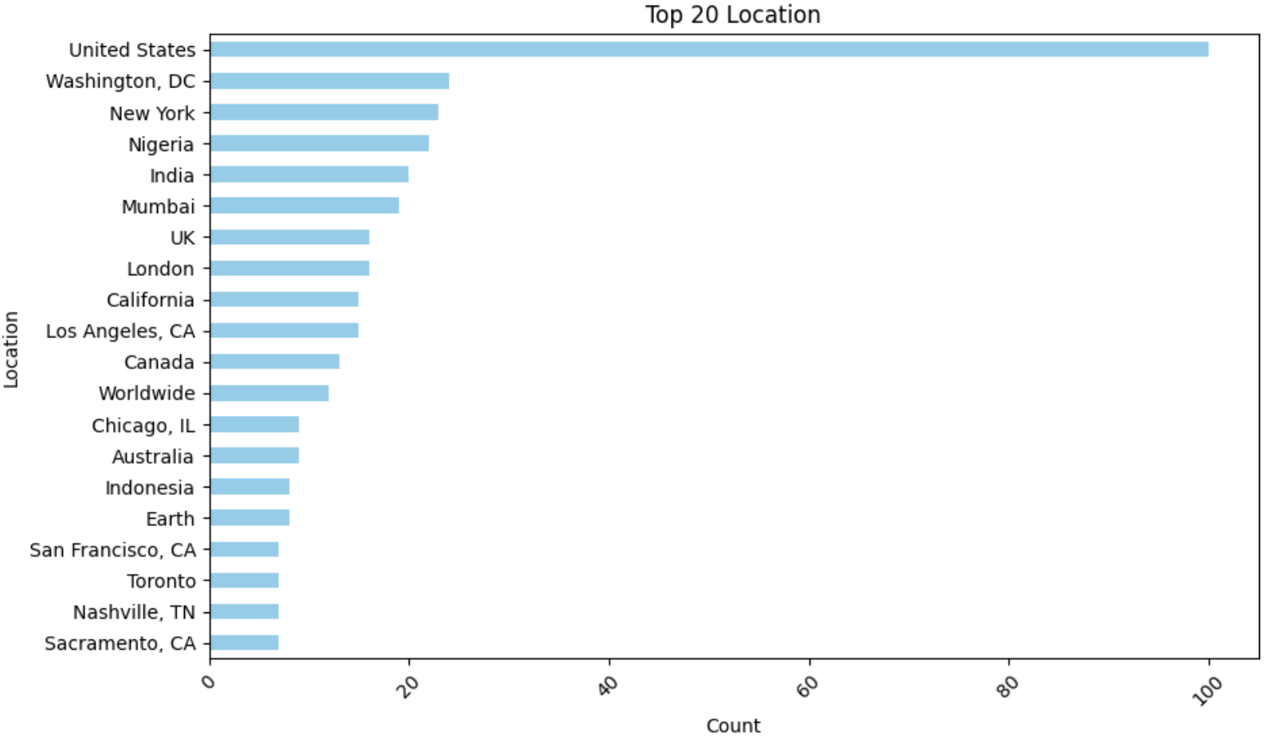
Data Preprocessing - Location
Text Cleaning
Mapping equivalences
Top 20 disaster related location from the training dataset
United States
Tarannum Zaki CS 834 - Intro to Information Retrieval Natural Language Processing with Disaster Tweets @tarannum_zaki @WebSciDL

Slide 7
Training Framework
Train-Test split
The training dataset is split into 20% testing and 80% training dataset.
Input feature: Text, Target variable: Label
TF-IDF Vectorization
To convert the textual data into numerical data
Creating a Pipeline
Having TF-IDF Vectorizer and ML models for fitting as steps
Training and Testing Data
Fitting pipeline on training dataset and predicting the test data
Evaluating Model Performance
Using Recall, Precision, and F1-score
Tarannum Zaki CS 834 - Intro to Information Retrieval Natural Language Processing with Disaster Tweets @tarannum_zaki @WebSciDL

Slide 8
Selected Models for Training
Logistic Regression
Random Forest
k-Nearest Neighbour (KNN)
Naive Bayes
Support Vector Machine (SVM)
Gradient Boosting
Kowsari, K., Jafari Meimandi, K., Heidarysafa, M., Mendu, S., Barnes, L., & Brown, D. (2019). Text classification algorithms: A survey. Information, 10(4), 150, https://doi.org/10.3390/info10040150
Tarannum Zaki CS 834 - Intro to Information Retrieval Natural Language Processing with Disaster Tweets @tarannum_zaki @WebSciDL

Slide 9
Performance of the Training Models
Models | Labels | Precision | Recall | F1-score
Logistic Regression | 0 | 0.78 | 0.89 | 0.83
 | 1 | 0.81 | 0.67 | 0.74
Random Forest | 0 | 0.78 | 0.84 | 0.81
 | 1 | 0.76 | 0.68 | 0.72
KNN | 0 | 0.77 | 0.84 | 0.81
 | 1 | 0.76 | 0.67 | 0.71
Tarannum Zaki CS 834 - Intro to Information Retrieval Natural Language Processing with Disaster Tweets @tarannum_zaki @WebSciDL

Slide 10
Performance of the Training Models
Models | Labels | Precision | Recall | F1-score
Naive Bayes | 0 | 0.79 | 0.89 | 0.84
 | 1 | 0.83 | 0.67 | 0.74
SVM | 0 | 0.80 | 0.84 | 0.82
 | 1 | 0.77 | 0.71 | 0.74
Gradient Boosting | 0 | 0.71 | 0.94 | 0.80
 | 1 | 0.85 | 0.47 | 0.61
Tarannum Zaki CS 834 - Intro to Information Retrieval Natural Language Processing with Disaster Tweets @tarannum_zaki @WebSciDL

Slide 11
Summary of F1-score on Training Models
Models | F1-score (Label 0) | F1-score (Label 1)
Naive Bayes | 0.84 | 0.74
Logistic Regression | 0.83 | 0.74
SVM | 0.82 | 0.74
Random Forest | 0.81 | 0.72
KNN | 0.81 | 0.71
Gradient Boosting | 0.80 | 0.61
Tarannum Zaki CS 834 - Intro to Information Retrieval Natural Language Processing with Disaster Tweets @tarannum_zaki @WebSciDL

Slide 12
Information Retrieval
Classification based on Keywords and Location
Tarannum Zaki CS 834 - Intro to Information Retrieval Natural Language Processing with Disaster Tweets @tarannum_zaki @WebSciDL

Slide 13
Current Work
Working on neural and transformer models to see if performance improves.
Considering contextual embeddings.
Models | Labels | Precision | Recall | F1-score
LSTM | 0 | 0.77 | 0.84 | 0.80
 | 1 | 0.75 | 0.67 | 0.71
Tarannum Zaki CS 834 - Intro to Information Retrieval Natural Language Processing with Disaster Tweets @tarannum_zaki @WebSciDL

Slide 14
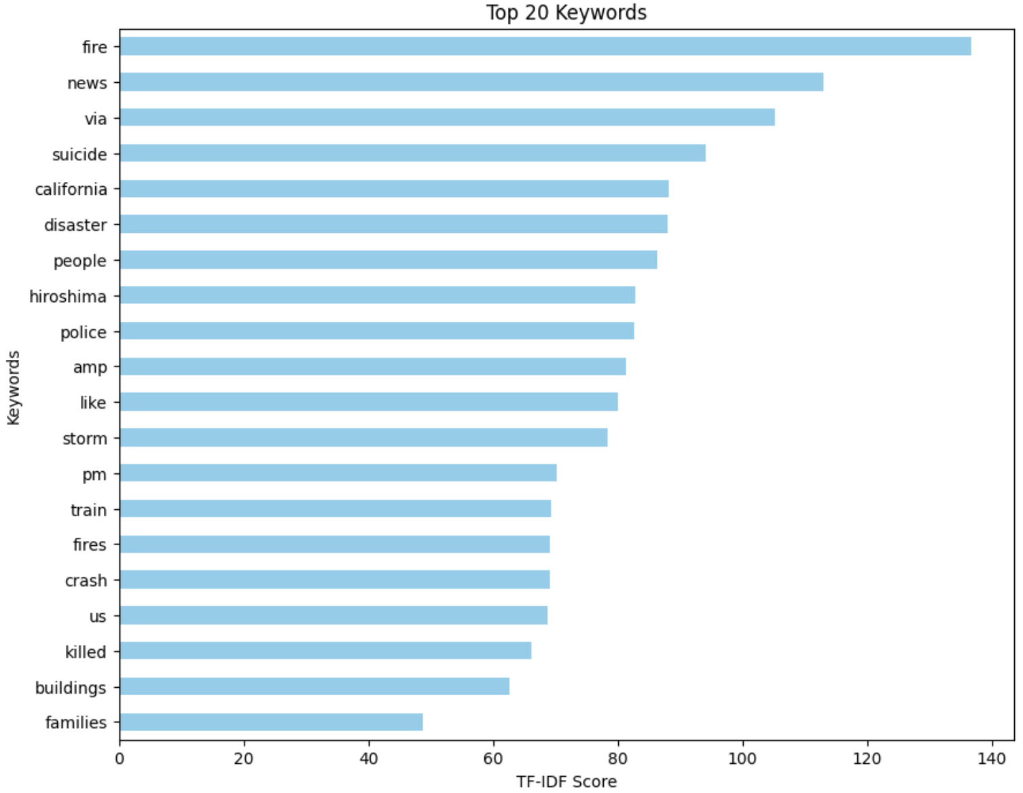
Current Work
Working on extracting top keywords considering contextual embedding.
Tarannum Zaki CS 834 - Intro to Information Retrieval Natural Language Processing with Disaster Tweets @tarannum_zaki @WebSciDL

Slide 15
Next Steps
Include some additional data processing.
Complete experiments with contextual embedding models.
Choose the best model and use to predict the test dataset.
Integrate the information retrieval part.
Tarannum Zaki CS 834 - Intro to Information Retrieval Natural Language Processing with Disaster Tweets @tarannum_zaki @WebSciDL

